Slide 1

Prediction of DDoS attacks in Cloud Environment
by
N.Jyothi
Roll No. 204G1A0546
G.Mahesh Kumar
Roll No. 204G1A0551
V.Meghana
Roll No. 204G1A0556
J. Ashok
Roll No. 204G1A0517
Under the guidance of
Dr. C. Sasikala M.Tech.Ph.D
Associate Professor
Department of Computer Science and Engineering
Srinivasa Ramanujan Institute of Technology
(Autonomus)
2023 - 2024

Slide 2

Contents
Prediction of DDoS attacks using Deep Learning
Abstract
Introduction
Literature Survey
Existing System
Proposed System
Planning
Design
Implementation
Results
Conclusion
Paper
References
A - 6

Slide 3
Abstract
Prediction of DDoS attacks using Deep Learning
In recent years, Internet services have been increased in public and business ventures for production tasks. So internet applications need a lot of security to secure the data of other businesses and also itself. DDoS attacks are major security risks in the application­ environment. It happens by sending thousands of requests to flood the server and prevent it from processing requests. DDoS attack is a significant cybersecurity challenge that makes a particular system or network out of reach and unusual for some time. It affects the server’s resources. The proposed system is used to detect such types of attacks by utilizing LSTM algorithm and a high level of accuracy. Hence, this work aims to solve this issue by applying a Long Short-term memory(LSTM) algorithm with a high degree of accuracy to detect these types of assaults. The suggested technique, which has a 93% accuracy rate in identifying DDoS attacks, will be evaluated and simulated using Python and it is compared with the exsisting machine learning algorithms.
Keywords:
Deep Learning, Long-short term memory, Distributed Denial-of-service(DDoS)attacks
A - 6

Slide 4
Introduction
Prediction of DDoS attacks using Deep Learning
DDoS attacks involve malicious efforts to overwhelm a target system or network with an excessive volume of traffic, causing disruption and rendering the services inaccessible to legitimate users. The dynamic and distributed nature of network infrastructures further complicates the detection and mitigation of such attacks. Traditional security measures, while effective to some extent, are often insufficient in addressing the evolving sophistication of DDoS attacks.
In recent years, the rapid proliferation of cloud computing has revolutionized the way organizations manage and deploy their IT infrastructure. Online environments offer scalability, flexibility, and cost efficiency, making them an attractive choice for hosting critical applications and services. However, this widespread adoption has also exposed server systems to an escalating threat landscape, with Distributed Denial of Service (DDoS) attacks emerging as a formidable challenge.
A - 6

Slide 5
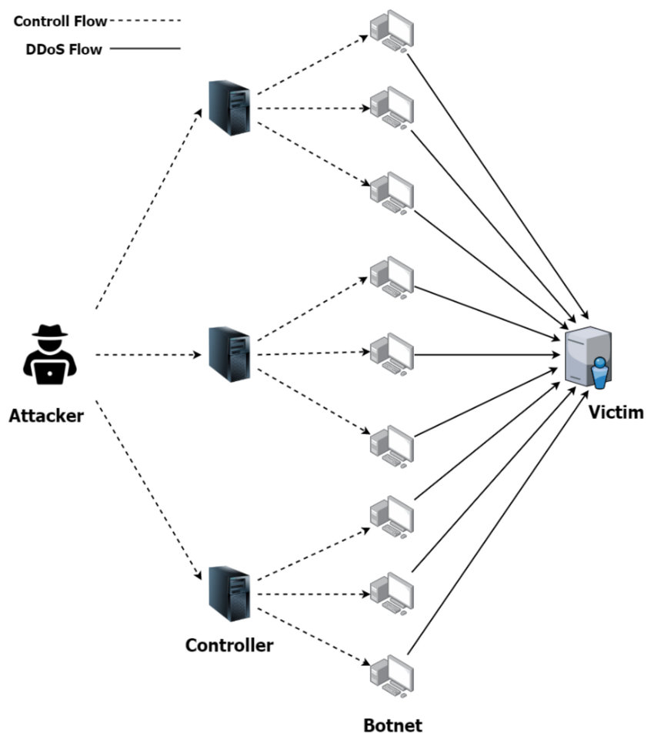
Prediction of DDoS attacks using Deep Learning
Visual Representation of DDoS Attacks
A -6

Slide 6
Problem Statement
Prediction of DDoS attacks using Deep Learning
The Internet environment needs a lot of security as there are many attacks are being occurred, and people are finding difficulty in approaching network or sever or services due to security issues.
So we are focusing on intrusion detection on DDoS attacks.
There are Server and Hosting issues in the Internet applications or websites from becoming overwhelmed and unavailable.
By using deep learning algorithms we can detect the DDoS attacks by using the most advanced dataset and reduce their effect.
A - 6

Slide 7
Prediction of DDoS attacks using Deep Learning
Prediction of DDoS attacks using Deep Learning
Literature survey
The insider DDoS attack is a primary challenge for any cloud operational environment because it deactivates the service completely.
In this proposed model DDoS attacks are detected easily in an optimized way by the GHLBO algorithm and this algorithm is helpful in training DSA that finds attacks efficiently.
The proposed model is analysed by three performance metrics such as TPR, TNR, and testing accuracy.[3]
The main idea of the proposed methodology is to detect DDoS attacks effectively by employing several steps like pre-processing, feature selection, and classification.
FS-WOA-DNN model helps applicants secure data from DDoS attacks. They attained an accuracy of 95.35%. [1]
A -6

Slide 8
Prediction of DDoS attacks using Deep Learning
Continue…
Literature survey
They used CIC IDS 2017 dataset as the input to our proposed system. It is the most widely used dataset to classify the existence of DDoS or Non-DDoS. Based on the parameters accuracy, precision, recall, and FAR, they conclude that Random forest is the best model to detect DDoS at the earliest.
Using the confusion matrix, the scatter plot of eight ML algorithms has been plotted. By comparing the parameters accuracy, precision, recall, and false alarm rate of eight algorithms, Random Forest produced the best results to detect the existence of a DDoS attack with a low false alarm rate of 0.05%. [5]
A -6

Slide 9
Prediction of DDoS attacks using Deep Learning
Prediction of DDoS attacks using Deep Learning
Continue…
Tabular Representation of Algorithms
Ref No. | Algorithms Used | Merits | De-merits
[1] | FS-WOA-DNN | To mitigate DDoS attack in effective manner The proposed algorithm stimulated using MATLAB tool. | We observed that they didn’t Use optimize approach to evaluate IP addresses.
[2] | Hybrid Intrusion Detection System using LSTM | To detect suspicious network traffic from any network nodes,with running datasets of IPs against it. | It can be enhanced using advanced IoT systems.
[3] | HTM and LSTM | The operation of this model is predicated primarily on the portion of the cerebral cortex known as the neocortex | attempting to map the relationship between cells and input data, and it is highly likely that we will be able to interpret the decisions of the proposed system
[4] | RBF networks,CNN | It is an hybrid model aiming to enhance security of cloud infrastructure. | It can be enhanced used on latest attacks
A -6

Slide 10
Prediction of DDoS attacks using Deep Learning
Prediction of DDoS attacks using Deep Learning
Continue…
Tabular Representation of Algorithms
Ref No. | Algorithms Used | Merits | De-merits
[5] | Logisitic Regression,RF, NB, Decision tree, SVM- Sigmoid,SVM-Polynomial,SVM-RBF | The eight models are trained and tested via K-Fold cross validation to find the best one to detect the DDoS attack at the earliest stage. | High data maintenance.
A -6

Slide 11
Existing System
Prediction of DDoS attacks using Deep Learning
EXISTING SYSTEM
In the existing system, the approach to tackling DDoS attacks involves a specific flow and relies on a set of techniques for model development. However, it has become evident that this approach encounters limitations, particularly in terms of memory utilization and the accuracy of results. To enhance the effectiveness of this system, incorporating machine learning methods, specifically DecisionTreeClassifier and GradientBoostingClassifier, offers several advantages over traditional techniques.
Disadvantages:
Data Imbalance
Overfitting
A -6

Slide 12
Proposed System
Prediction of DDoS attacks using Deep Learning
We propose an innovative application that can be considered a highly useful system, as it addresses the limitations commonly encountered with traditional and other existing methods for DDoS attack detection. The primary objective of this study is to develop a fast and reliable method that accurately detects the effects of Distributed Denial of Service (DDoS) attacks. In designing this system, we have leveraged the capabilities of a powerful algorithm in a Python-based environment, which includes the integration of Long Short-Term Memory (LSTM) neural networks.
A -6

Slide 13
Prediction of DDoS attacks using Deep Learning
Proposed System
Advantages of the Proposed System:
1. Early Threat Detection: Deep learning models can analyze network traffic patterns and anomalies in real-time, enabling early detection of potential DDoS attacks. This allows for timely mitigation before the attack disrupts services.
2. Improved Accuracy: Deep learning algorithms can learn and adapt to evolving attack strategies, making them more accurate in distinguishing between legitimate and malicious traffic. This reduces false positives and minimizes the chances of blocking legitimate users.
3. Behavior-Based Detection: Deep learning models can analyze the behavior of incoming traffic, looking for patterns associated with DDoS attacks, rather than relying on static rules. This makes them more adaptive and effective in identifying novel attack vectors.
A -6

Slide 14
Prediction of DDoS attacks using Deep Learning
Planning Objectives
Objectives of Planning:
Objective-1: To detect the DDoS attacks using the Long short-term memory algorithm.
Objective-2: To create a front-end design for the model and compare it with Machine Learning algorithms.
Cost :
• Mode = Organic
• Effort = 16 Person-Month Development
• Time = 4 Months
• Average Staff Required = 4 Persons
A -6

Slide 15
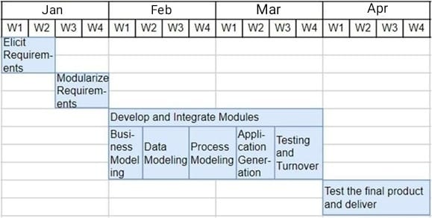
Prediction of DDoS attacks using Deep Learning
Planning Objectives
Time: On a whole this project takes about 4 months (16 person-months) of time period for development and testing.
Fig 1: Modeling steps in each module
A -6

Slide 16
Prediction of DDoS attacks using Deep Learning
Planning Modules
Modules:
Data Pre-processing
Building LSTM model
Comparing LSTM model with Machine Learning models
Website building for user approach
A -6

Slide 17
Prediction of DDoS attacks using Deep Learning
Planning Functional and Non – Functional Requirements
Functional Requirements:
Give a network address inputs to the system.
Process and take inputs and classify whether it is attack or not.
Show the percentage accuracy of LSTM model and ML models.
Non-Functional Requirements:
Usability: The application is easy to use with very less complexity of interface.
Availability: Available within the device.
Scalability: This model can be trained for other DDoS attacks.
Performance: Performs well with no sort of failures.
A -6

Slide 18
Prediction of DDoS attacks using Deep Learning
Planning System Requirements
Software Requirements:
Visual Studio App
Hardware Requirements:
Processor: Minimum Intel Core I5
RAM: Minimum 8 GB
Hard Disk: Minimum 250 GB
Operating System: Windows
A -6

Slide 19
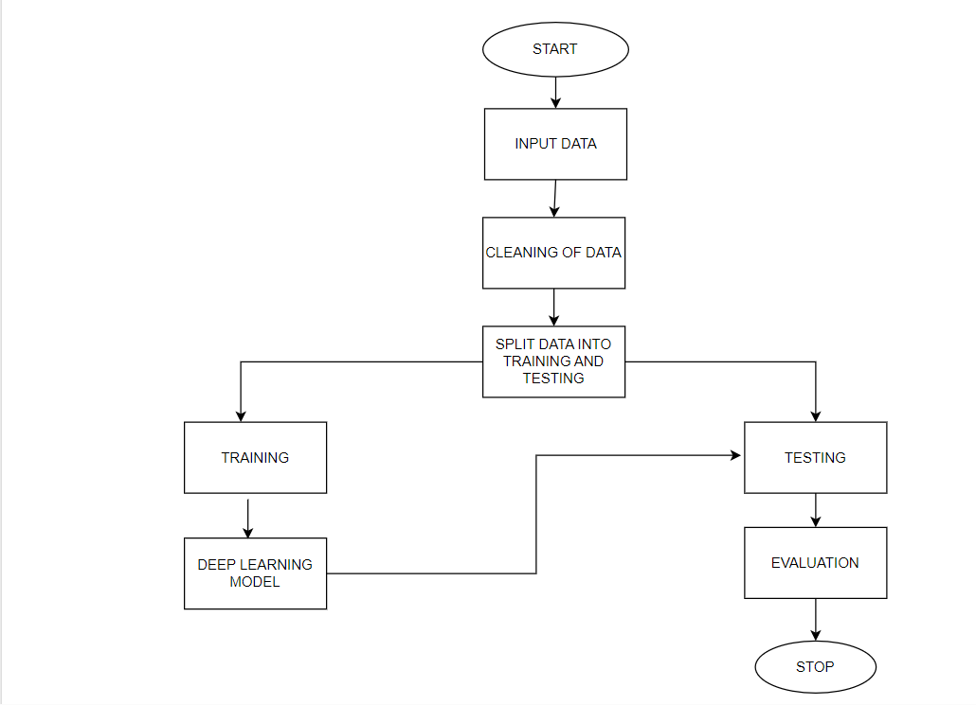
Prediction of DDoS attacks using Deep Learning
Design
Fig 4:Architecture of proposed method
A -6

Slide 20
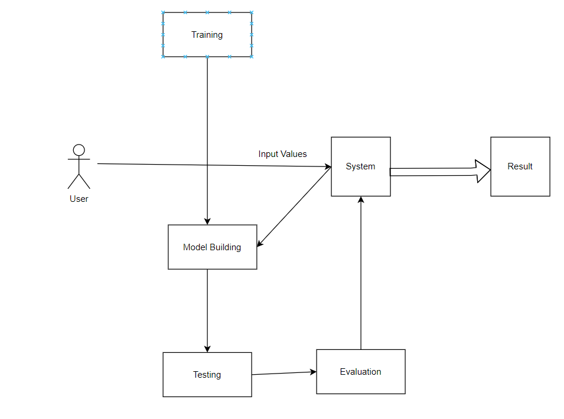
Prediction of DDoS attacks using Deep Learning
Design
Fig 2: GUI Interface
A -6

Slide 21
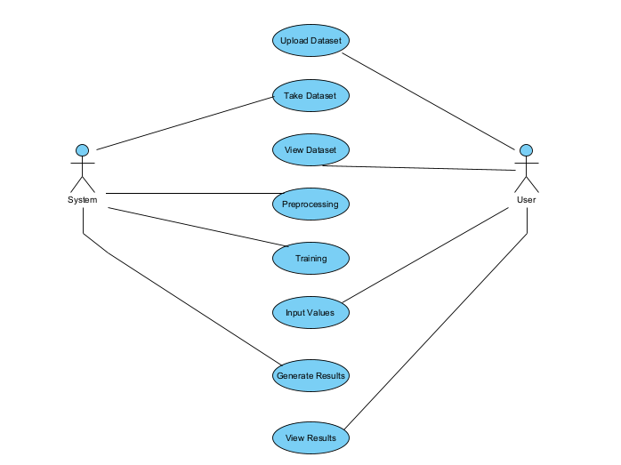
Prediction of DDoS attacks using Deep Learning
Design
Figure: Use Case Diagram
A -6

Slide 22
User
Prediction of DDoS attacks using Deep Learning
Prediction of DDoS attacks using Deep Learning
Upload Dataset: In this module, users have the capability to upload their dataset, typically in a specified format (e.g., CSV, Excel, or database connection). The system should provide clear instructions on the accepted data format and structure, ensuring a seamless data upload process.
View Dataset: Users can view the dataset they have uploaded. The system may provide features for data visualization, filtering, and summary statistics to help users understand and explore the dataset before initiating the prediction process.
Input Values for Prediction: Users need to provide input values relevant to the prediction task. These inputs could include specific data points or variables necessary for the model to make predictions. The system should guide users on what input is required and validate the inputs to ensure they meet the necessary criteria.
A -6

Slide 23
System
Prediction of DDoS attacks using Deep Learning
Take the Dataset: The system takes the dataset uploaded by the user and stores it securely. It performs data integrity checks and ensures that the dataset is available for further processing.
Preprocessing: In the preprocessing phase, the system cleans and prepares the data for model building. This involves handling missing values, data transformation, normalization, and feature engineering. It is a critical step to ensure the dataset is ready for training.
Training: The system utilizes machine learning or deep learning techniques to build a predictive model based on the preprocessed dataset. This may involve splitting the data into training and testing sets, selecting an appropriate algorithm, and training the model on the training data. The model is then evaluated for its performance on the testing data.
A -6

Slide 24
Continue…
Prediction of DDoS attacks using Deep Learning
Generate Results: Once the model is trained, the system uses it to generate results. For a DDoS attack prediction system, this could mean evaluating whether the input values provided by the user are indicative of an attack or not. Results may be presented to the user in a user-friendly format, such as a binary classification (e.g., "Attack Detected" or "No Attack Detected") or with probability scores. Users may also receive insights or visualizations that help them understand the model's decisions.
A -6

Slide 25
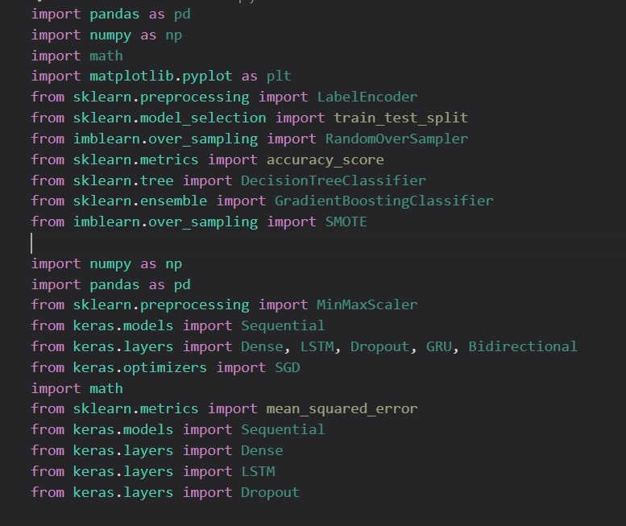
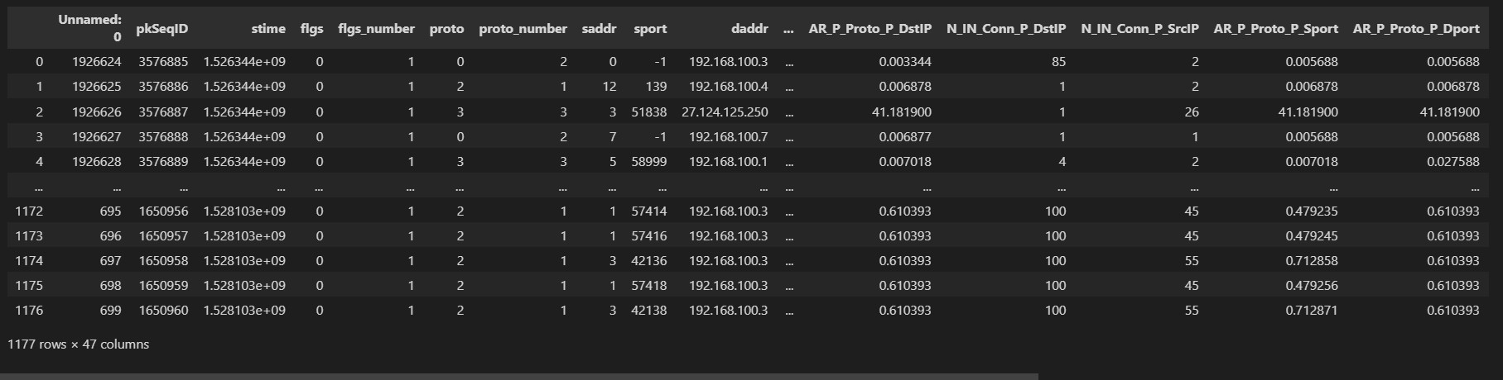

Prediction of DDoS attacks using Deep Learning
Implementation
Figure Dataset used
Figure Imported libraries
A - 6

Slide 26
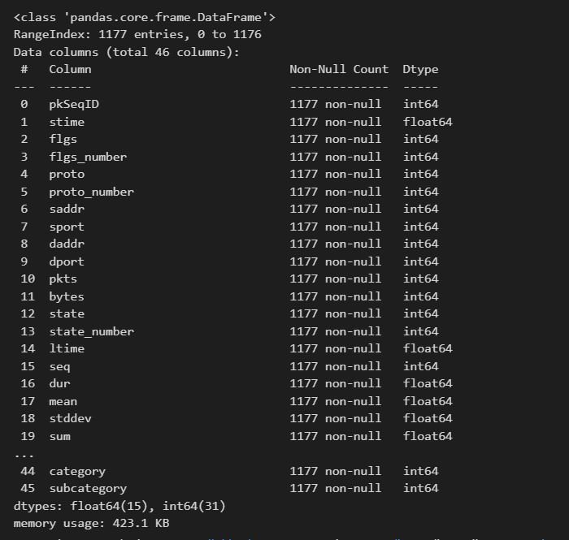
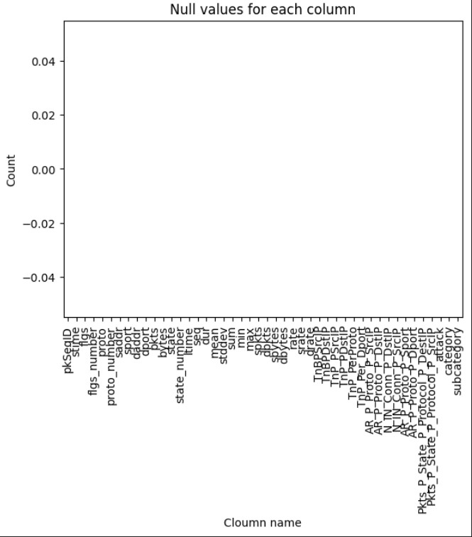
Prediction of DDoS attacks using Deep Learning
Implementation
Fig: Heatmap of missing values
Fig Concise summary of dataset
A -6

Slide 27
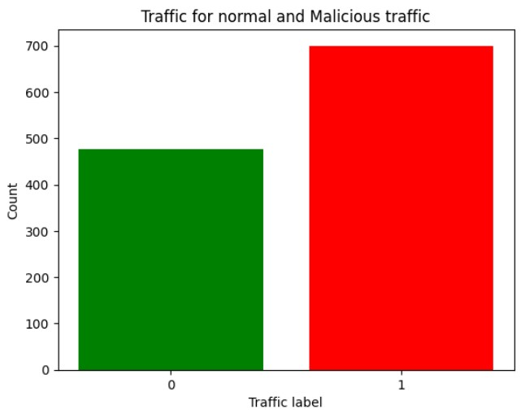
Prediction of DDoS attacks using Deep Learning
Implementation
Fig :Bar plot of Target Class
A -6

Slide 28
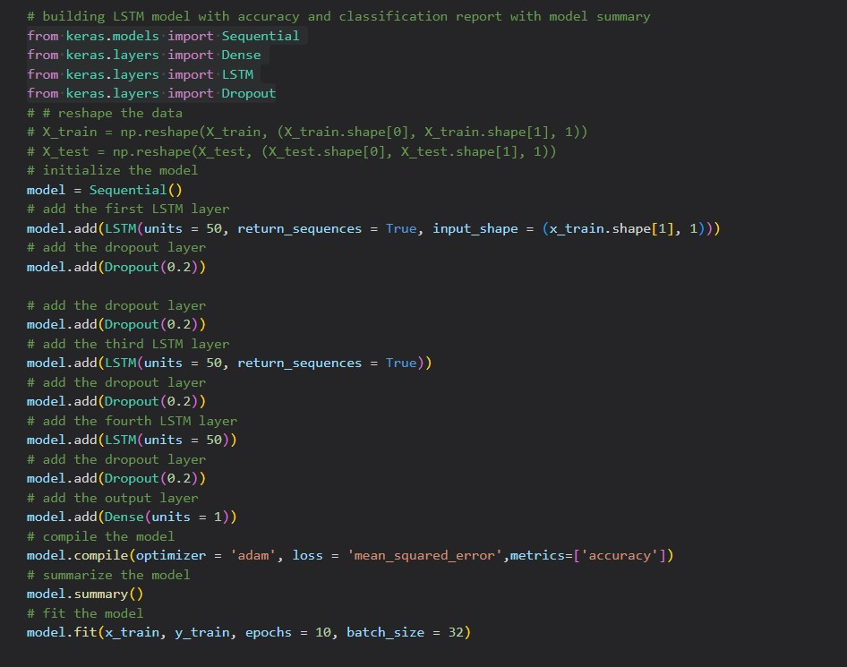
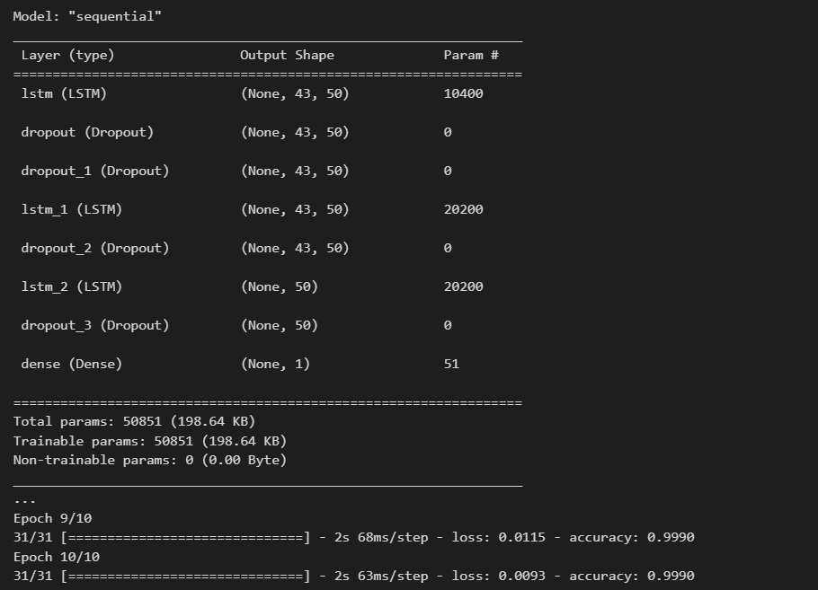
Prediction of DDoS attacks using Deep Learning
Implementation
Fig : Model Creation, Model Traing of LSTM
A -6

Slide 29
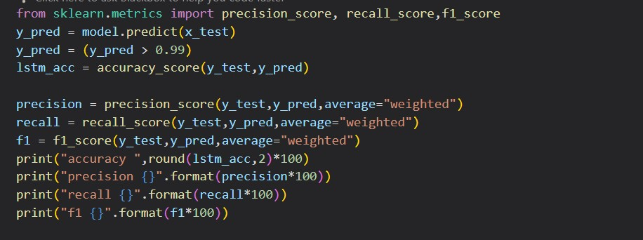
Prediction of DDoS attacks using Deep Learning
Implementation
Fig :Model Testing with LSTM
A -6

Slide 30

User Interface Results
Prediction of DDoS attacks using Deep Learning
Home Page:
A -6

Slide 31

User Interface Results
Prediction of DDoS attacks using Deep Learning
Load data:
A -6

Slide 32

User Interface Results
Prediction of DDoS attacks using Deep Learning
View Data:
A -6

Slide 33

User Interface Results
Prediction of DDoS attacks using Deep Learning
Select Model:
A -6

Slide 34

User Interface Results
Prediction of DDoS attacks using Deep Learning
Prediction:
A -6

Slide 35
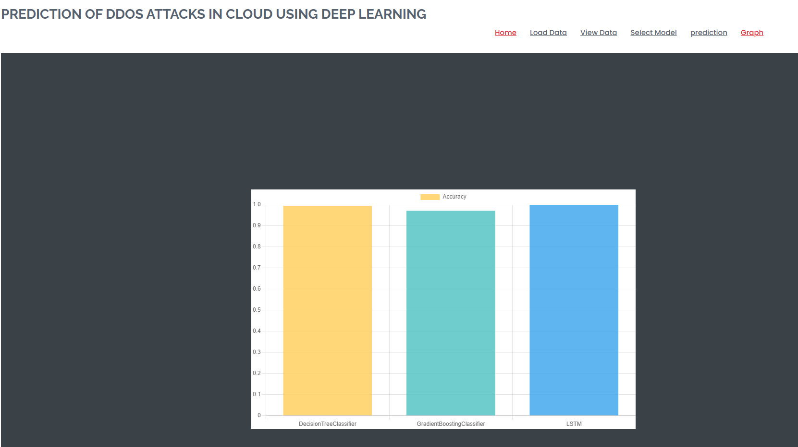
User Interface Results
Prediction of DDoS attacks using Deep Learning
Graph:
A -6

Slide 36
Prediction of DDoS attacks using Deep Learning
Results
Accuracy:
The proportion of correctly classified instances among the total predictions is known as accuracy. It is calculated by dividing the number of correct predictions by the total number of predictions and is commonly used as a performance metric in classification models. Higher accuracy values indicate better model performance in terms of correct classifications.
Precision:
The accuracy of positive predictions is measured by precision, which represents the ratio of true positives to the sum of true positives and false positives. Precision provides insights into the reliability of positive predictions, emphasizing the ability of a model to avoid false positives and make accurate positive classifications.
A -6

Slide 37
Prediction of DDoS attacks using Deep Learning
Results
Recall:
The ability of a model to capture all relevant instances is assessed by recall, which represents the ratio of true positives to the sum of true positives and false negatives. High recall values indicate the model's effectiveness in identifying a significant portion of the actual positive instances, minimizing false negatives.
A -6

Slide 38
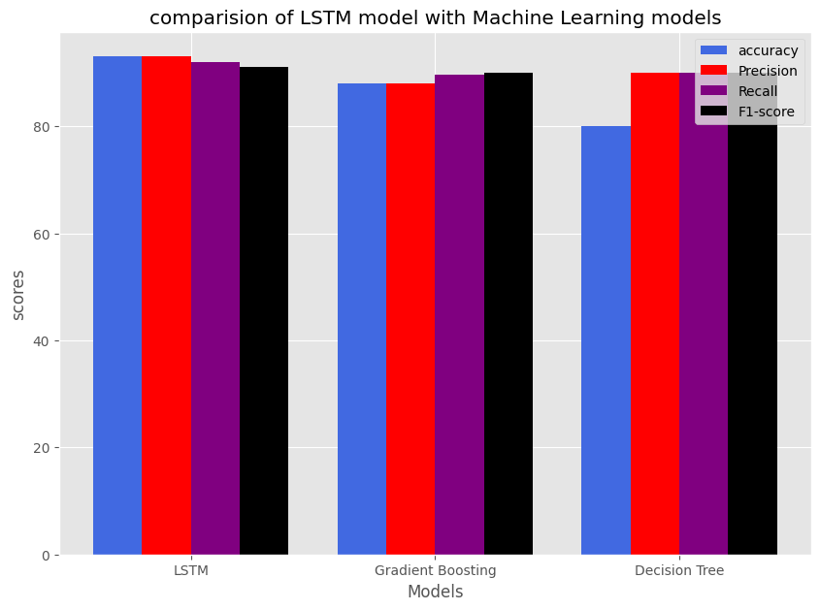
Prediction of DDoS attacks using Deep Learning
Comparision of LSTM model with ML models
Algorithms | Accuracy | Precision | Recall | F1-score
LSTM | 93% | 93.39% | 92.33% | 91.33%
Gradient Boosting | 88% | 88.72% | 89.61% | 90.61%
Decision Tree | 80% | 91.7% | 90.2% | 90.07%
Fig : Tabular representation of models and Graphical represention of LSTM model and Decision Tree and Gradient Boosting classifier
A -6

Slide 39
Prediction of DDoS attacks using Deep Learning
Conclusion and Future Work
In the contemporary landscape, DDoS attacks pose significant threats. To mitigate the associated losses by promptly identifying targeted networks, we have developed a model leveraging the LSTM algorithm. This model exhibits a remarkable accuracy of 93%, surpassing established machine learning counterparts such as Decision Tree and Gradient Boosting algorithms. Implemented in Python, our solution not only enhances detection capabilities but also operates seamlessly in real-time network environments, providing a superior and intuitive solution. To ascertain whether or not the network is under assault, the system probably collects user data. For Future work, this model can be enhanced to cloud environment as the cloud is the most targeted place by the DDoS attackers which may affect the organizations.
A -6

Slide 40


Prediction of DDoS attacks using Deep Learning
Paper
Fig 34: Acceptance of paper from CBIT and Payment proof
A -6

Slide 41
References
Prediction of DDoS attacks using Deep Learning
[1]. Ankit Agarwal, Manju Khari, Rajiv Singh, “Detection of DDOS Attack using Deep Learning Model in Cloud Storage Application”, Springer Nature, pp. 1-21, 4 February 2021.
[2]. Mohammad Shurman, Rami Khrais, and Abdulrahman Yateem, “DDoS and DDoS Attack Detection Using Deep Learning and IDS “,pp. 1-8, The International Arab Journal of Information Technology · July 2020.
[3].Marram Amitha, Dr. Muktevi Srivenkatesh, “DDoS Attack Detection in Cloud Computing Using Deep Learning Algorithms”, pp. 1-10, Intelligent Systems and Applications in Engineering, 2023.
.
A -6

Slide 42
References
Prediction of DDoS attacks using Deep Learning
[4]Li Xinlong and Chen Zhibin, “ DDoS Attack Detection by Hybrid Deep Learning Methodologies”, pp. 1-8, Hindawi Security and Communication Networks, May 2022
[5]. C M Nalayinil, Dr. Jeevaa Katiravan, “Detection of DDoS attack using Machine Learning Algorithms”, Journal of Emerging Technologies and Innovative Research(JETIR), vol.9, pp. 1-10, July 2022.
.
A -6

Slide 43

Git Hub Dashboards of each student
Prediction of DDoS attacks using Deep Learning
A -6

Slide 44
Prediction of DDoS attacks using Deep Learning
Any Queries?
A - 6

